Slide 1
A Story About Recreation, Culture & Music Therapy at the Louis Brier Home & Hospital

Slide 2
Once upon a time in a facility not so far away…
There was once a recreation department made up of many creative people who developed a wide range of exciting programs and events for residents living at the Home for the Jewish Aged, known as the Louis Brier.
During this fruitful time, the recreation department established a reputation within the region as an organization that offered residents living there an exceptional range of recreation and leisure programs.

Slide 3
It was a wonderful time…

Slide 5
The Chaplain moved to Milwaukee – and we were without for quite some time….
1 Recreation Therapist went on Maternity Leave
The Music Therapist/Volunteer Coordinator retired
The Manager was on medical leave for almost 8 months to get two brand new knees…

Slide 6
The Music Therapist stepped into the role of Acting Manager and continued her work as Music Therapist…and while juggling both jobs, she then took on a third job in Quality Risk Management.
The fulltime Program Coordinator left to work at the Weinberg Residence *the lure of Monday – Friday
The 2nd Recreation Therapist left the LB for another job…

Slide 7
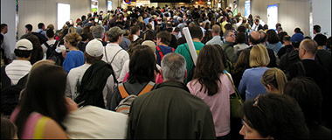
It felt like everyone was leaving…

Slide 8
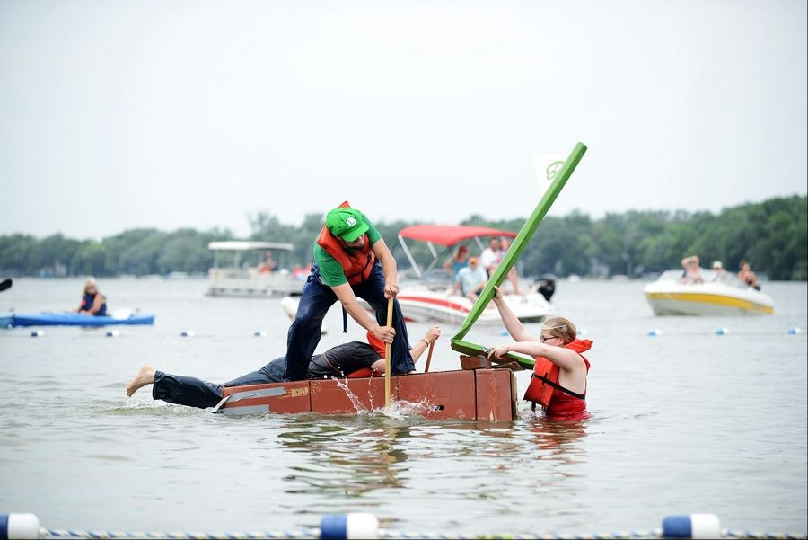
…and they were!
The department underwent significant change that affected many people during a relatively short period of time.
And it became very difficult for the team who wanted to continue doing great things…
with so few people
on the team
to do them.

Slide 9
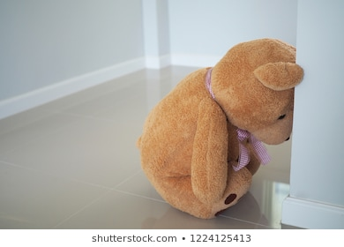
It was a difficult time for many people…
For the residents,
their families…
As well as for everyone
who relied on the recreation team to bring opportunities to the residents.

Slide 10
It was also very hard
for the recreation team
which was now
very,
very,
small.

Slide 11
It was very hard on them.

Slide 12
However……
Even though they were now a very small team, they continued to
work as hard as they could
to maintain
the standard of programming excellence
that
everyone enjoyed.

Slide 14
What this truly meant:
The former flourishing and successful
department went from
7 FTE (and a full time manager) to 2.5 FTE

Slide 15
But they persevered… and they hung in there !

Slide 16
And then slowly, things began to

Slide 17
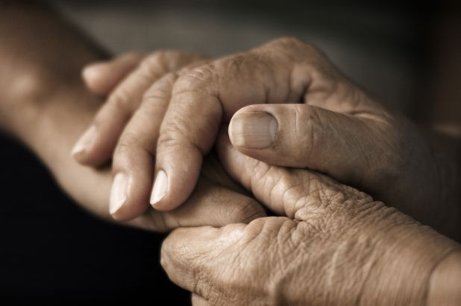
The Manager came back to work (with her two new knees)
A Volunteer Coordinator was hired
A Chaplain was hired.

Slide 18
And Then…
Vancouver Coastal Health awarded LB with a financial award for their excellence in charting & documentation.
The financial award was designated to support Allied Health, and the Recreation Department was funded for 4.4 full time equivalent staff (FTE).

Slide 19
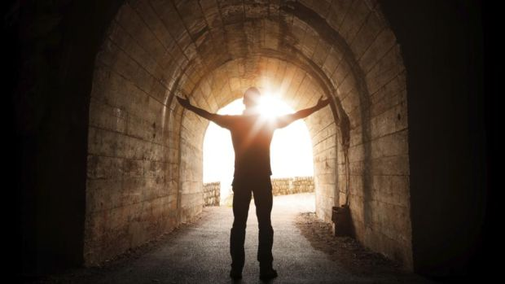
There was now a VERY BRIGHT LIGHT at the end of the tunnel!!!

Slide 20
It was a celebration!

Slide 21
We immediately hired AMAZING people!
ONE FTE Recreation Therapist
TWO FTE Recreation Therapy Assistants
TWO part time Recreation Therapy Assistants

Slide 23
And the Program Coordinator who went to the Weinberg…

Slide 24
She came back to the Louis Brier!
Because a very special position was created specifically for her:
The Jewish Cultural Program Coordinator

Slide 25
Meet Our New Team
Edy Govorchin | Manager Recreation, Culture & Music Therapy | Monday – Friday
Kelly Lopuch | Recreation Therapist | Monday – Friday
Natalie Jacobs | Recreation Therapist | Monday – Friday
Jessica Shen | Music Therapist | Monday – Friday
Charlotte Vogt | Program Coordinator | Wednesday- Friday
Rachel Worth | Jewish Cultural Programmer | Monday – Friday
Rob Menes | Chaplain | Monday – Friday
Melissa Bates | Recreation Therapy Assistant | Monday – Friday
Maria Villamor | Recreation Therapy Assistant | Monday – Friday
Chen Yue Guo | Recreation Therapy Assistant | Monday – Friday
Kim Silver | Recreation Therapy Assistant | Monday – Thursday
Bert Munn | Recreation Therapy Assistant | Monday - Wednesday

Slide 26
So what does this all mean?

Slide 27
An increase of 154%
(that doesn’t include the manager with the new knees)

Slide 28
The Staffing Changes:
From 2.5 FTE in May 2019
to
9.1 FTE in December 2019

Slide 29
The Program Changes: What we offered in May 2019

Slide 30
And in just a few months…

Slide 31
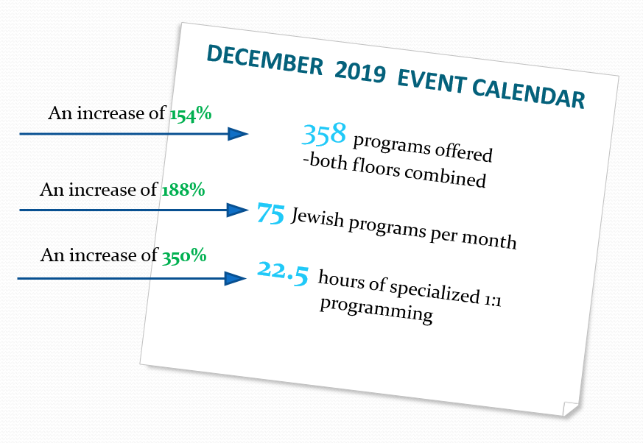
The Program changes: What we offered in December 2019:

Slide 32
SCU Programming grew too!
May 2019
39 programs per month
December 2019
82 programs per month

Slide 33
But, we had a problem…

Slide 34
How do we fit ALL the NEW programs into the Event Calendar and WHERE do we offer all of these NEW programs?
The calendar format did not support the number of programs that are offered because the calendar cells were much too small.

Slide 35
To simply summarize….
Things were great…Things were not so great… things got great again and will continue to get even better!

Slide 36
Initiatives we are working on:
Initiated ActivityPro, a web-based software tool to evaluate and document resident engagement
Continued collaboration with academic institutions for onsite learning opportunities (Capilano University for Music Therapy and Douglas College for Recreation Therapy).
Music Therapy interns and practicum students are in place.
Mandatory training/education for department employees as well as providing quarterly education to further develop best practice initiatives.
Re-development of the Spiritual Care program
Development of a database for 1:1 specialized programming
Evaluation and development of Spiritual Care and Recreation Assessments for greater relevancy to professional practice.

Slide 37
And….
Collaboration with Nursing and Food Services departments to enhance resident’s dining experience in the 1st fl D/R
Successful grant: 2.75 hours/week of additional music therapy
Development of restorative care program for care staff, families and volunteers to access & utilize
Updating and restructuring employee routines and schedules
Integrating LEAN initiatives within the department
Recreation office moving to accommodate growth within department

Slide 38
Looking ahead to….
Development of a Lifelong Learning initiative program for residents.
Utilizing innovative technology to support opportunities for lifelong learning
Developing our intergenerational program opportunities.
Broadening our musical performance database.

Slide 39
And finally….
Our continued commitment providing innovative, evidence-based recreation and leisure services that support personhood, opportunities for self-determination and the utilization of strengths while engaging in meaningful leisure in an inclusive environment.

Slide 40
Thank you for your interest.

